Slide 1

MCDM Approach For Diet Recommendation System
MINI PROJECT PRESENTATION
Presented By:
Karandeep : 014
Akash Gupta : 202
Manini Chawla : 354
Kunal Jain : 411
Shashank : 005(LE)
Under the guidance of :
Dr. Narina Thakur

Slide 2
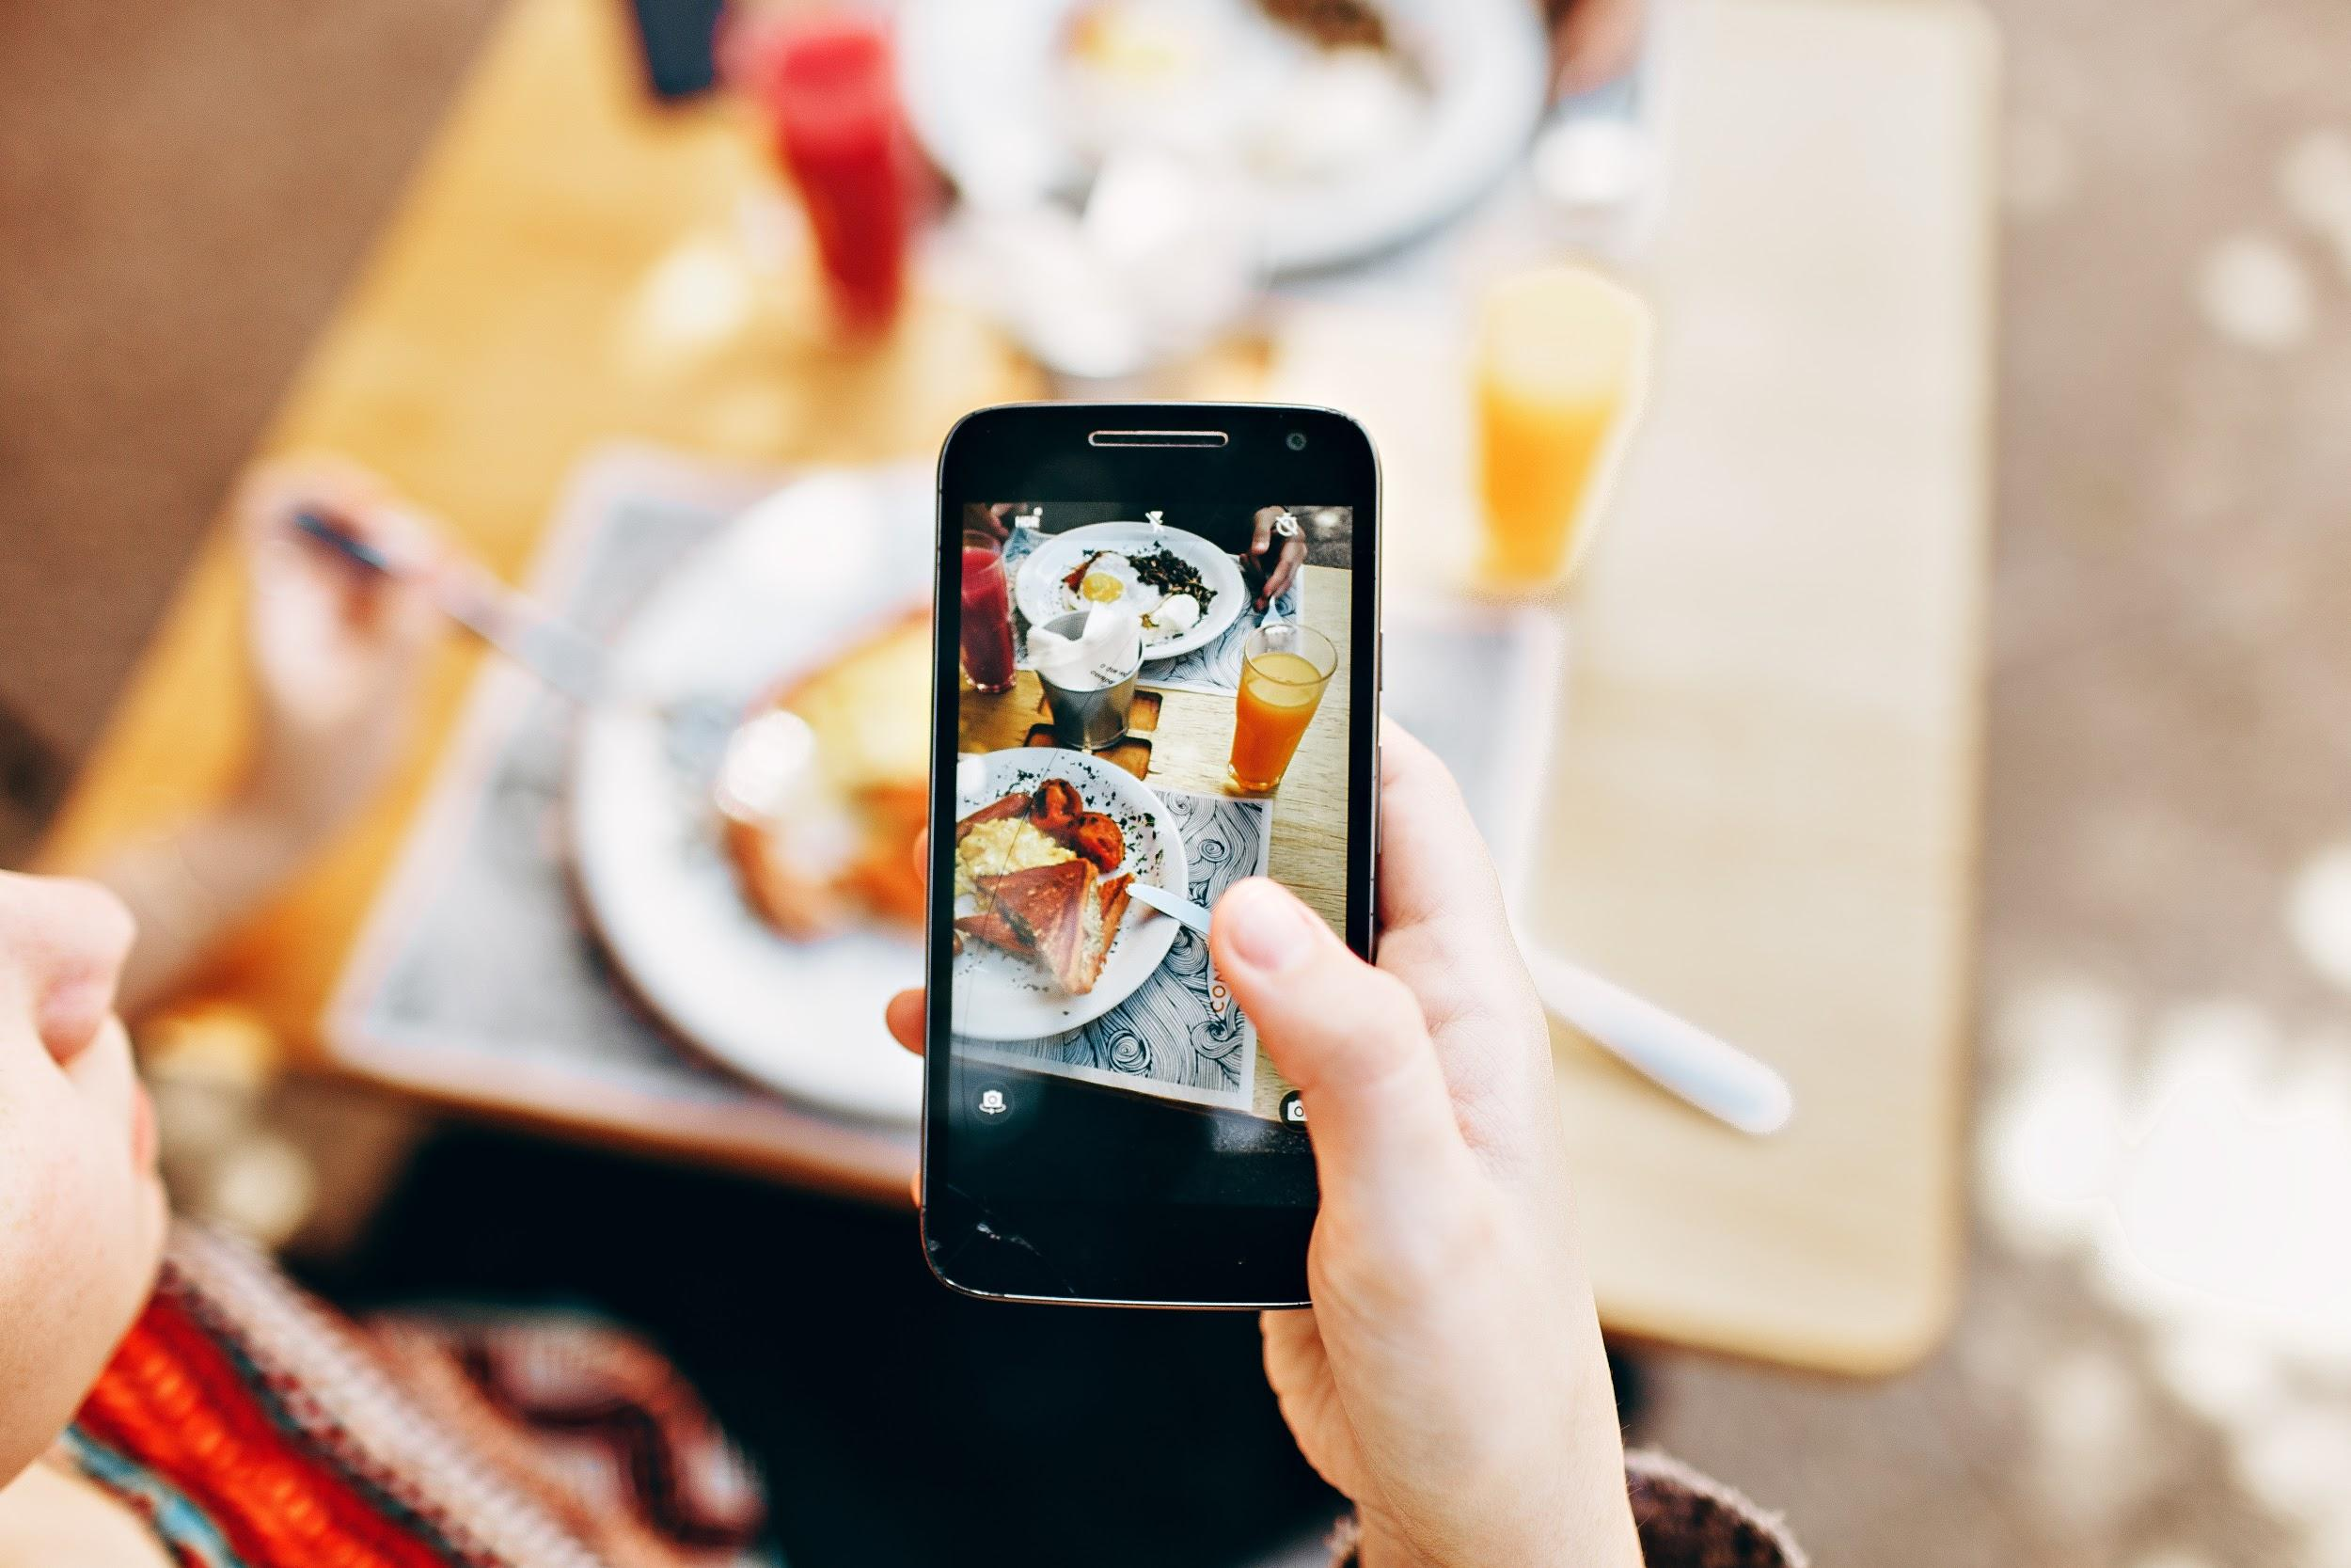
Existing system requires hiring of a dietitian in order to get consultation for our diet plan.
Hiring a dietician requires a lot of time, effort and money.
Times when the dietitian is not available for us and we would have to search for some other dietitian urgently.
So in order to escape from such problems it is ideal to use an online diet recommendation system.
PROBLEM STATEMENT

Slide 3

Introduction
People are moving towards achieving a fit and healthy body and crave for healthy and nutritious food to be placed on their plates.
Diet consultation system is an application with artificial intelligence about human diets.
Data entered by the user and is processed to provide a diet plan to the user.
Analytical Hierarchical Process (AHP) of MCDM method is used to suggest the best diet for the users.

Slide 4

Approach used for solving, ‘decision making and planning problems’ involving multiple criteria.
MCDM is implemented in our diet recommendation system by taking in account several factors including height, weight, working hours and diseases (if any) for an individual and will suggest diet accordingly.
Using MCDM we will recommend a list of diets to the user based on priority, also suggesting future benefits associated with that diet
MCDM

Slide 5

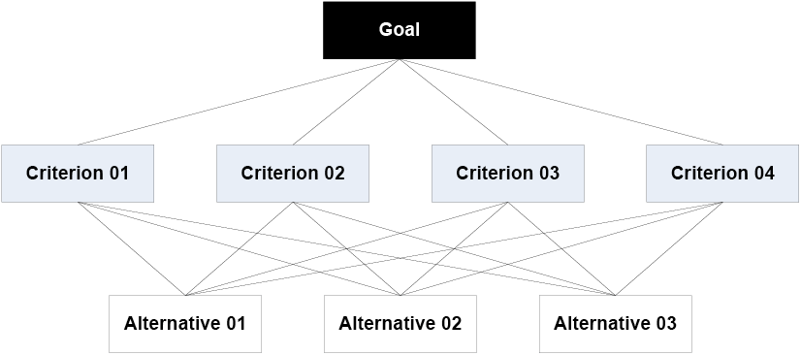
AHP
AHP helps decision makers find one that best suits their goal and their understanding of the problem.
Users of the AHP first decompose their decision problem into a hierarchy of sub-problems, each of which can be analyzed independently.

Slide 6
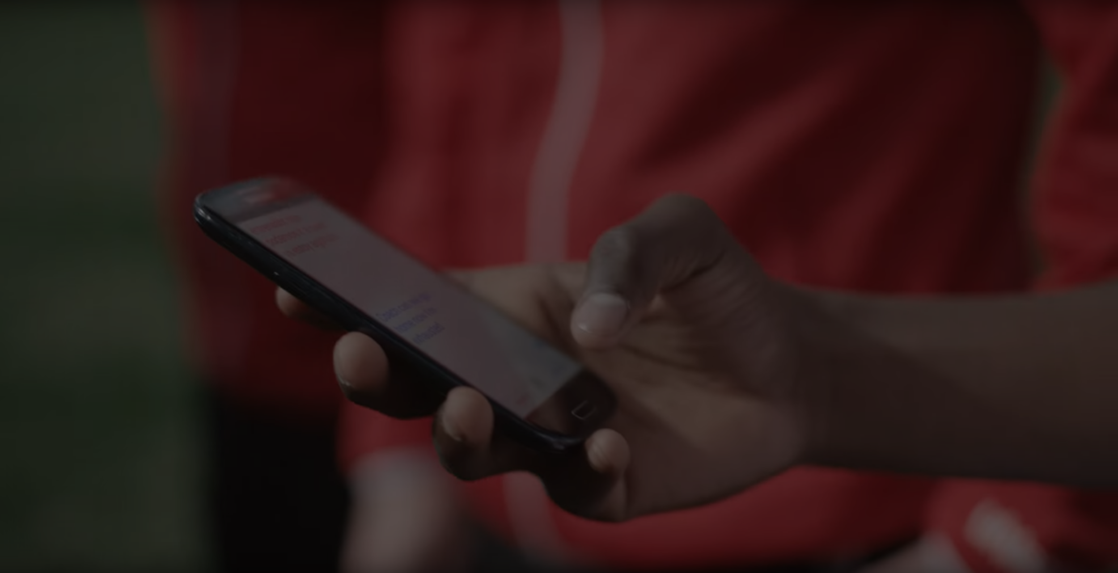
Case Based Reasoning
Case-based reasoning (CBR) is the process of solving new problems based on the solutions of similar past problems.
Assumptions
Similar problems have Similar solutions.
(e.g., Low fat food can be taken for any obesity related problems like Heart disease ,High blood pressure and Diabetes).
If something true today will probably true tomorrow.
(e.g., if you have a obesity, you should workout, because it has always helped).
Notes:
Akash bhai check kr lio
Mane example change kr dia hai

Slide 7
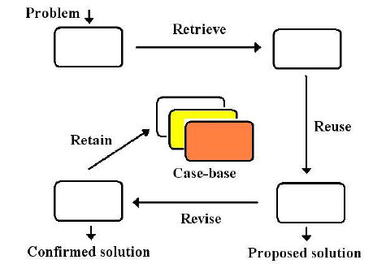
CBR Cycle
Case Based Reasoning cycle is a four step process.
Retrieve:
Determine most similar case(s).
Reuse:
Solve the new problem re-using information and knowledge in the retrieved case(s).
Revise:
Evaluate the applicability of the proposed solution in the real-world.
Retain: Update case base with new learned case for future problem solving.

Slide 8
Modules To Be Implemented
Individual User Profile
Personal Information, Diet Habits, Interests, Hobbies, Disease, if any
Guest Login
Health and Proper Diet Based Blogs, Scanner Feature
Dietitian Profile
Personal Information, Portal Access for referral of users directly.

Slide 9

Advantages
No need of consulting doctor for diet plans.
Saves money and very effective and give accurate results as the recommendation system is designed through MCDM and CBR approach.
There are alternative diet chart provided by the system if the user don't like any.

Slide 10

Applications:
Dietitians can use this system to make sure what they recommend patients.
This system can be very well used in medical colleges for teaching and practicing purposes so that student can learn from it.
This system can also be utilized in gym particularly for calculating the customers' calories and diet plans.
Individual can use this software especially for themselves in home.

Slide 11
Conclusion
Hiring a dietitian to get a consultation for the diet plan requires much time, efforts and cost.
So, we have proposed the diet recommendation system using MCDM approach.
A person just has to give some information about its body type, weight, height, and working hour details. This system will suggest diet according to his goals and health status.
If a person doesn’t like the food under first preference or having allergy with it, he can pick the food of lower preferences as well.

Slide 12
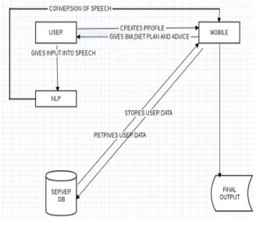
Future Scope
Interaction between guider and dietitian through video calling and secured prescription will be focused upon.
Speech recognition for input and output of data through NLP.
The Activity Tracker for tracking the user steps including the walking, running and stairs time along with the total step taken in a day.

Slide 13
Plan Of Action
September-October
January
November-December
February
March
MCDM and CBR model
Integration and Testing
Intensive Research and Creation of SRS document
 | 2019 |  |  |  | 2020
Data fetching through APIs and visits to dietitians
Front End Development

Slide 14


